Slide 1
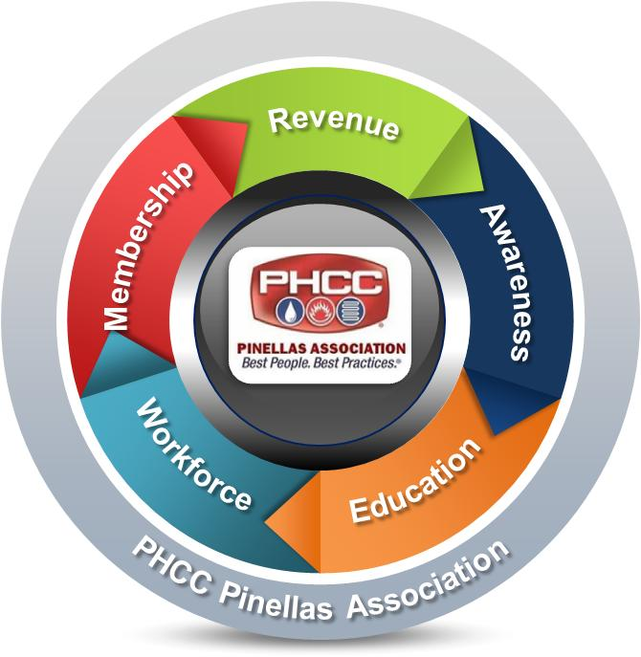
5 Critical Focus Areas
Success
Road Map
Our Mission . . .
PHCC Pinellas is dedicated to the promotion, advancement, education and training of the industry for the protection of the environment, and the health, safety and comfort of the Tampa Bay area.
(855) NOW-PHCC
info@paphcc.com
www.paphcc.com
Our Vision . . .
PHCC will become so relevant that PHCC Pinellas contractors are the best choice for professionalism, reliable products, and knowledgeable service.
(855) NOW-PHCC
info@paphcc.com
www.paphcc.com
P.O. Box 3572
St. Petersburg, FL 33731
(855) NOW-PHCC
info@paphcc.com
www.paphcc.com

Slide 2
Strategic Goals
5 Year Plan
2019 Goals
2018 Goals
Rationalization
Membership
Ten (10) new members.
Minimum 90% retention rate.
Awareness
Add/utilize at least two (2) communication tools (i.e. social media, newspaper articles).
Execute one (1) community event.
Workforce
Identify one (1) new recruitment resources.
Increase member awareness of job opportunities, job fairs, etc.
Increase apprenticeship program with three (3) additional students y-o-y.
Revenue
Create and execute at least two (2) fundraising campaigns/events that provide the greatest impact for investment.
Identify one (1) other avenue for continued revenue.
Education
Increase relationships y-o-y with Industry Partners to provide specialized expertise for product and program development.
Increase y-o-y convention/tradeshow participation and attendance from contractors, manufacturers, suppliers & service providers.
Enhance opportunities to attend meetings, i.e. virtual option.
Add at least one (1) business class, one (1) personal finance class, one (1) journeymen training, one (1) HVAC related training.
Membership
Increase members and increase retention rate as this is viewed as essential to contractor success and strengthens our voice and impact.
Awareness
PHCC Pinellas members are recognized as contractors of choice resulting in increased member success.
Workforce
Workforce shortages undermines the success of our members and is paramount that we take action to attract skilled workers.
Education
Providing education and product knowledge offerings will enhance the growth and success of our members and their workforce.
Revenue
Revenue is a critical component for PHCC Pinellas to successfully carry out its mission.
100 members.
Public awareness of PHCC Pinellas and its members are recognized for Plumbing and HVAC/R expertise.
Reduce workforce shortages within PHCC Pinellas reach.
Diverse Revenue Streams. Membership dues not to exceed 30% of revenue.
Education and product knowledge one-stop resource to members.

